Slide 1
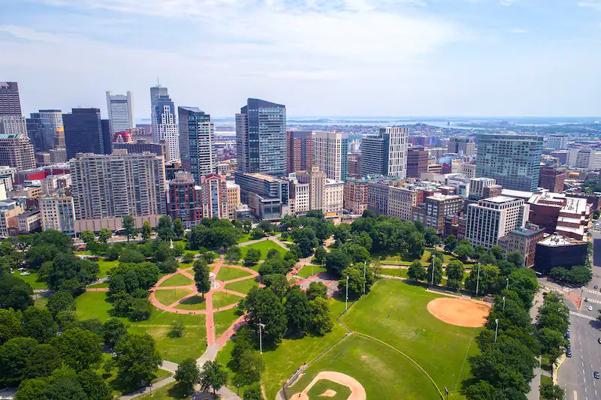
Gun Violence
Gun Violence - Team 3
Team Members:
Sarah Bonna (Team Lead),
Brian Mahabir,
Shivangi,
Showndarya Madhavan

Slide 2
Gun Violence
Project motivation:
Recent uptick in gun possession among youth in Boston's District 4
Need to understand the drivers of gun violence in the district and the city as a whole.
Inform policies that can improve the district and reduce the incidence of gun violence.

Slide 3
Gun Violence
Project Goal
To understand the drivers of gun violence in Boston's District 4 and the city as a whole, with a focus on identifying the variables associated with increases or decreases in gun violence.

Slide 4
Gun Violence
Project Background
To understand the project, it would be helpful to have knowledge of the factors that contribute to gun violence, such as poverty, access to firearms, mental health, and social dynamics.
Familiarity with the existing programs designed to address gun violence, their effectiveness, and their limitations would also be useful.

Slide 5
Project Extension Proposal
Rationale
To highlight potential important environmental trends which can pave the way for approvals for redesigning areas of Boston
Hypothesis
Greener environments have less violence than desolate urban settings.
More gun violence incidents closer to community centers.
More details found here:
Extension Proposal

Slide 6
Progress so far
Datasets used/to be used
Gun Violence
City Council Dataset
Shots Fired
Shootings
Community Centers
Parks
Explored the Community Centers dataset
Focused on Community Centers dataset to create mappings to City Council Districts
No concrete analysis derived from parks dataset

Slide 7
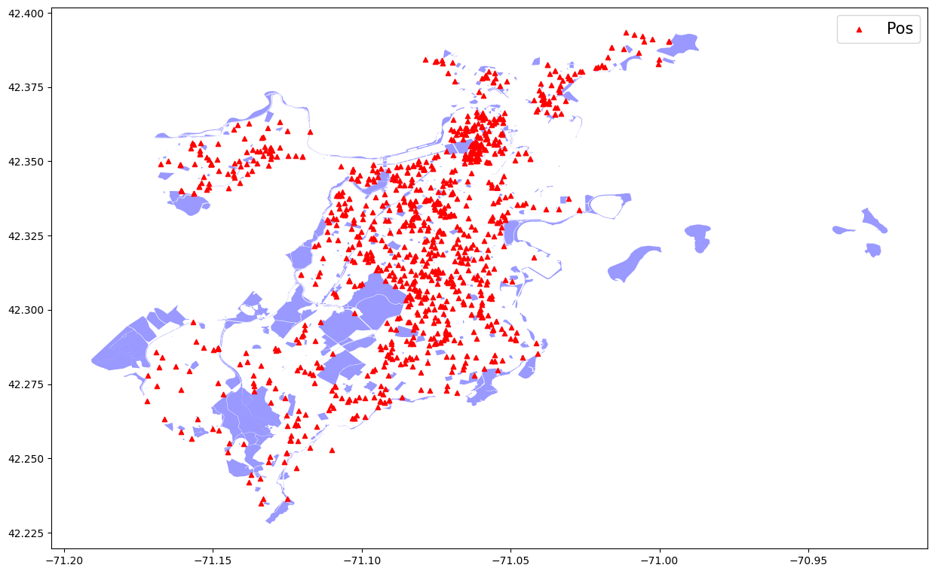
Parks Gun Violence Map
Key Findings:
Most gun violence does not happen in parks
Boston has a high park area ratio to city its hard to say if shootings happen near parks with this bias

Slide 8
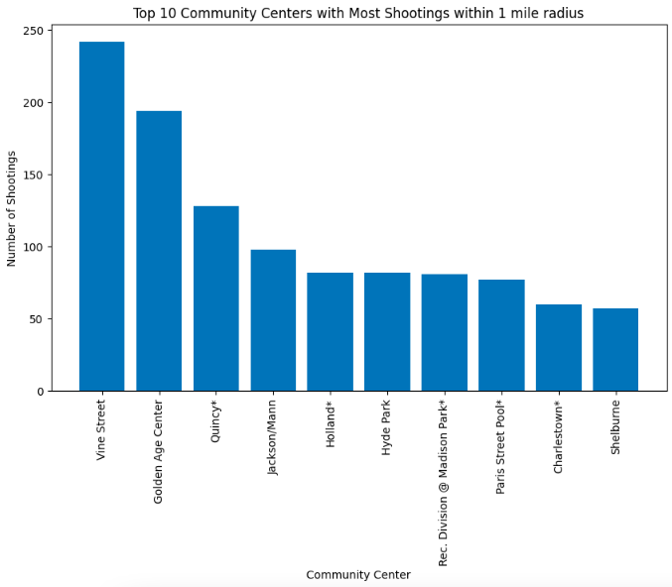
Top 10 Community Centers with Most Shootings
Key Findings:
More shootings near Community Centers seem to happen in City Council 1 and 7, with 3 Community Centers each in the top 10 list.
There are only one Community Centers from City Councils 4, 2, 9 and 5 in the top 10 list.

Slide 9
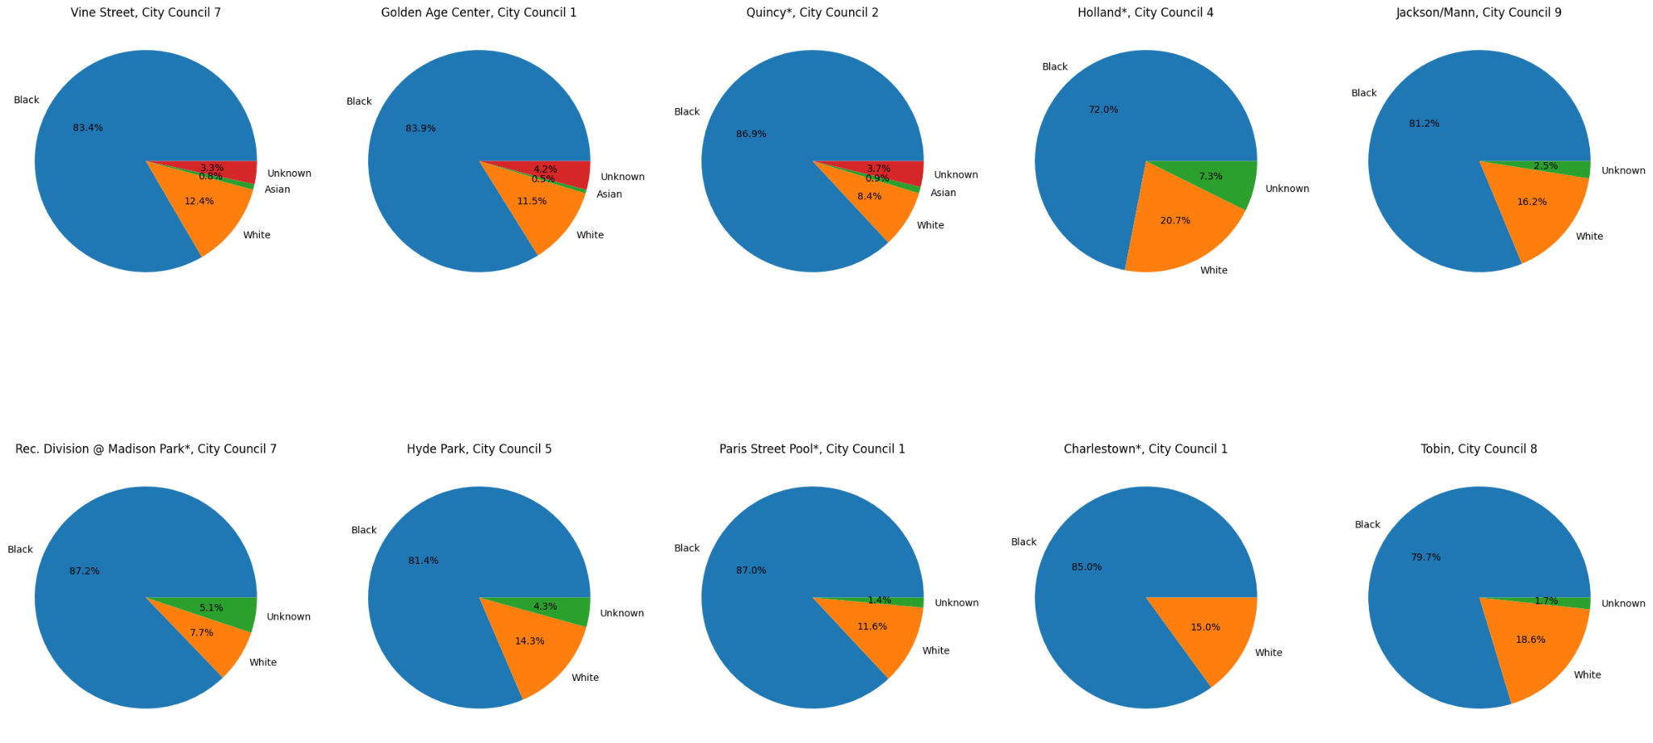
Race Segmentation for Community Centers

Slide 10
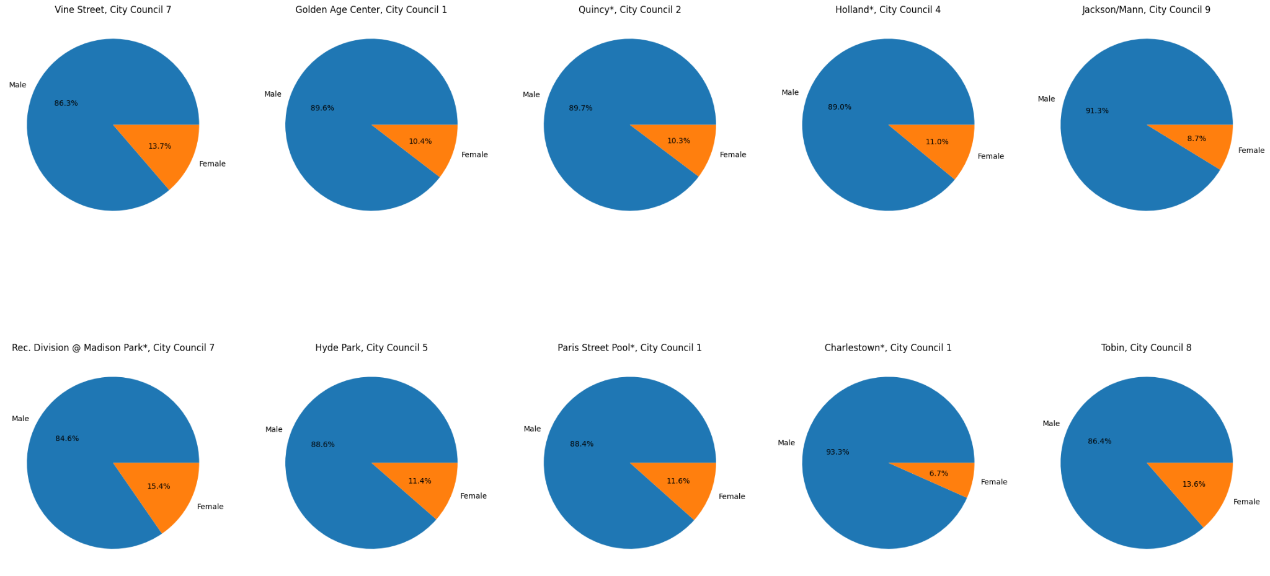
Gender Segmentation for Community Centers

Slide 11
Race and Gender Graphs Key Findings
Race
In every Community Center on the top 10 list, more than 75% of the victims are Black.
The Community Center at Holland (City Council 4) has the highest number of White and Asian victims out of the Community Centers in the top 10 list at 19.5% and 1.1 % respectively.
Gender
In all the Community Centers in the top 10 list, there are always more male victims than female victims (more than 80% of the victims are males in every case vs more than 8% for females).
Golden Age Community Center in City Council 1 has the highest percentage of male victims at 91%, whereas for females, it is at Charlestown also in City Council 1, with 17%.

Slide 12
Next steps
Questions/Obstacles
Wrap up the report and final analysis.
We ain't got none for now!

Slide 13
Questions?
Gun Violence

